Slide 1






Bengaluru Urban Traffic Flow and Mobility Insights
Explore and analyze traffic conditions across major Bengaluru areas and intersections in order to understand congestion patterns, mobility dynamics, and the impact of environmental and situational factors on urban traffic flow.
Agenda
Project Title & Dataset
Problem Statement
Data Cleaning
Exploratory Data Analysis
Group Analysis
Advanced-Python Techniques
Insights & Conclusions
Team 09:
Pranay Srivastava
Mohan R. Sadasivam
Tanu S V
Prasad K. Bhat
Ullas Raghavan
Vihaa H. Shetty

Slide 2
Project Title, Dataset, Problem Statement
Project Title:
Bengaluru Urban Traffic Flow and Mobility Insights
Dataset Overview and Summary
Dataset: Bangalore City Traffic Dataset
Platform: Kaggle
Dataset URL: https://www.kaggle.com/datasets/preethamgouda/banglore-city-traffic-dataset
🔗 Source
The data was collected from the Government of Karnataka's open datasets, which provide real-time traffic information. This data was then processed and merged to create a comprehensive overview of Bangalore’s traffic patterns for the year 2022. Government of Karnataka, recorded at various key intersections and roads in Bangalore. The data was further aggregated and merged from multiple sources to create a detailed dataset suitable for smart city and urban planning analysis.
Dataset Size and Structure
Number of Records: 8,000+ rows
Number of Features: 15+ columns
Data Format: CSV
Temporal Coverage: Multi-month / multi-year observations (date-based records)
Define the problem:
To analyze and understand the key factors contributing to traffic congestion and mobility inefficiencies across Bengaluru by examining traffic volume, speed patterns, congestion levels, environmental impact, and situational influences such as weather and roadwork activity.
Why this dataset?
The Bengaluru Traffic Dataset is chosen because it provides a rich, multi-dimensional view of real-world traffic behavior in one of India’s most congested metropolitan cities. Unlike simple traffic datasets that only contain vehicle counts or speeds, this dataset integrates traffic flow, environmental conditions, mobility usage, infrastructure factors, and situational influences, making it ideal for comprehensive urban mobility analysis..
What questions will your EDA answer?
EDA will reveal where, when, and why Bengaluru’s traffic congestion occurs, and which factors most strongly influence mobility, delays, and environmental impact.

Slide 3
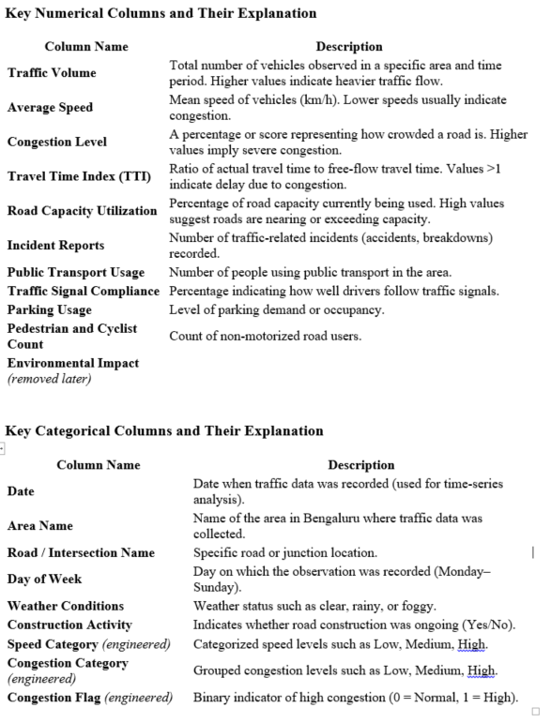
Data Cleaning
Missing value handling & Duplicate removal:
Missing value detection: df.isnull().sum() gives a clear overview.
Numeric imputation: Filling with mean is a quick fix.
Categorical imputation: Mode replacement ensures no empty categories.
Congestion level : imputed using median, which robust against skewness and outliers.
Duplicate handling: Detects and removes duplicates efficiently. 404 duplicate rows handled.
Data type corrections
Date handling template: Stored as an object/string, preventing time-series analysis hence converted to date=based feature.
Numerical Type Corrections: Some columns that should contain numeric data were stored as objects or had mixed formats.
Categorical Data Standardization: Several categorical fields were stored as strings but required normalization and consistent formatting. Trimmed whitespaces. Cleaned and standardize category labels. Eliminated inconsistencies “koramangala”, “Koramangala ”, “KORAMANGALA”.
Inspection outputs:
Dataset shape after cleaning.
Data types for all columns.
Remaining missing values.
Preview of first 5 rows.
Unique counts for categorical columns.
This gives you a clear snapshot of dataset health before moving into EDA.

Slide 4
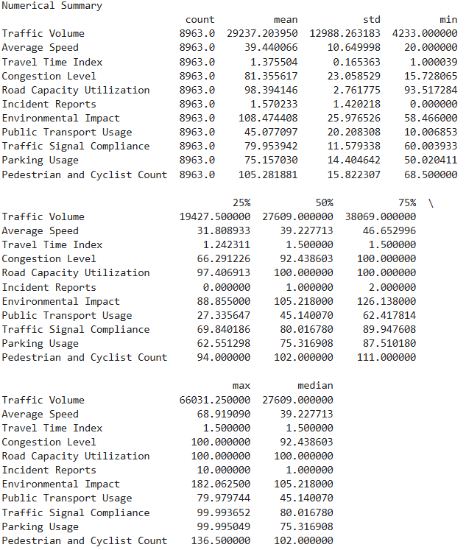
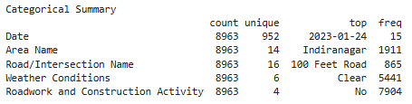
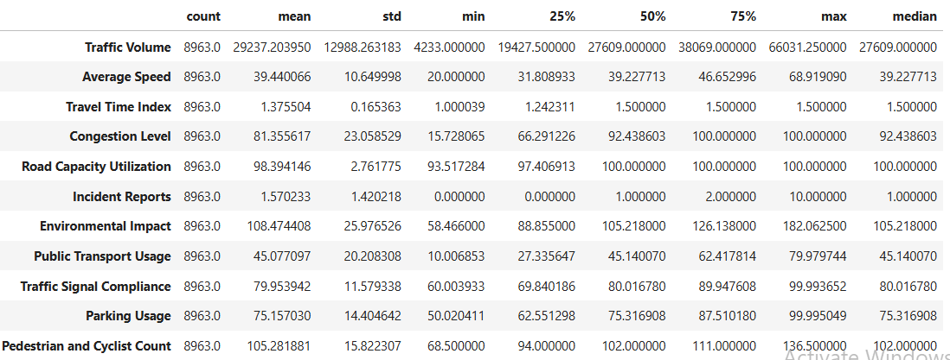
Exploratory Data Analysis(EDA) – Descriptive statistics
Summary statistics (numerical & categorical)

Slide 5
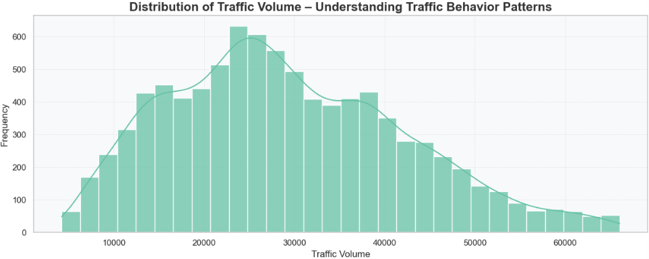
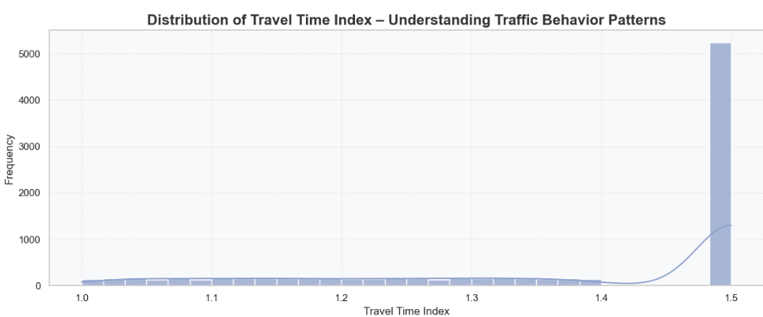
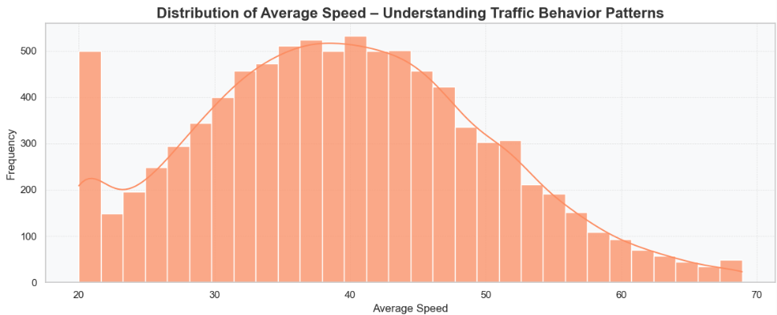
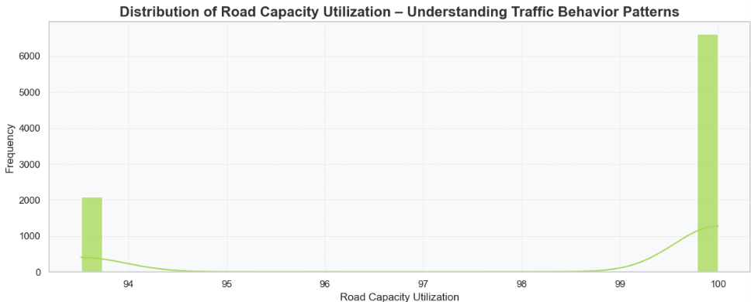
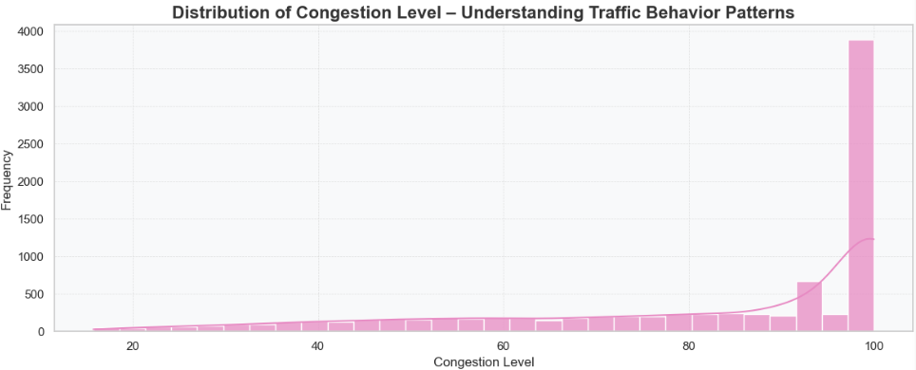
EDA – Data Visualization- Bar Plots
🚗 1. Traffic Flow Indicators
Traffic Volume
Distribution is moderately right-skewed.
A large concentration of traffic lies between 15,000–30,000 vehicles, indicating heavy routine flow.
A long tail toward 60,000+ suggests extreme congestion events on major corridors (e.g., Silk Board, Marathahalli).
Insight: Bengaluru’s road network experiences consistently high traffic, with occasional severe spikes that stress road capacity.
Average Speed
Roughly bell-shaped distribution with most speeds between 30–45 km/h.
Very low speeds (<20 km/h) appear during peak congestion.
Very high speeds (>60 km/h) occur only in low-traffic zones or off-peak hours.
Insight: Speed varies widely, highlighting chronic slowdowns in core urban areas and occasional free-flowing conditions in less dense regions.
Congestion Level
Highly right-skewed with most observations near 90–100%.
Indicates near-saturated traffic conditions across multiple locations.
Insight: Congestion is a persistent and widespread issue, not just an occasional peak-hour phenomenon.
Travel Time Index:
Most values lie between 1.1–1.4, showing delays of 10–40% over free-flow travel time.
Higher spikes indicate severe congestion episodes.
Insight: Travel delays are systemic, affecting daily commuting efficiency.
Road Capacity Utilization:
Distribution tightly packed near 98–100%.
Suggests roads are almost always operating at or beyond intended capacity.
Insight: Infrastructure is consistently strained; even minor disturbances cause significant traffic buildup.

Slide 6
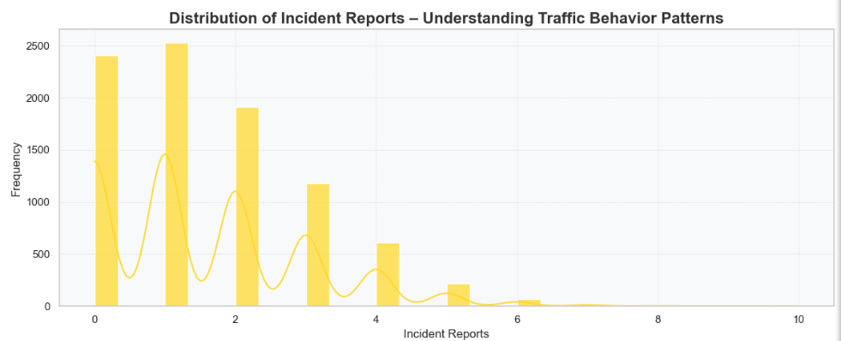
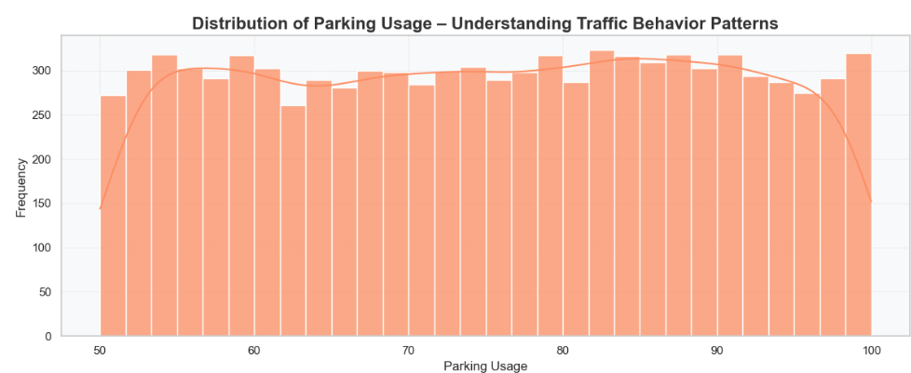
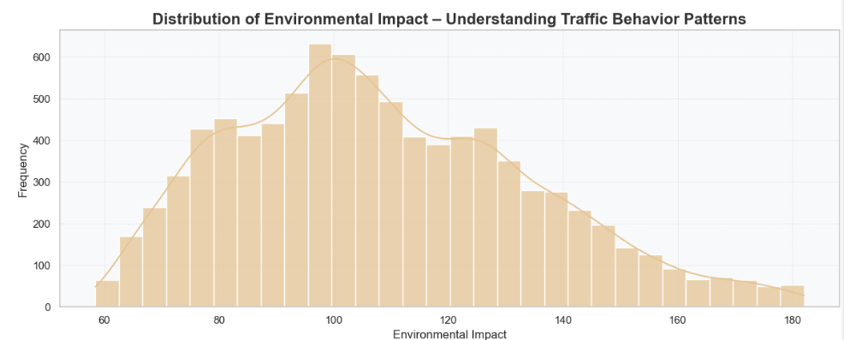
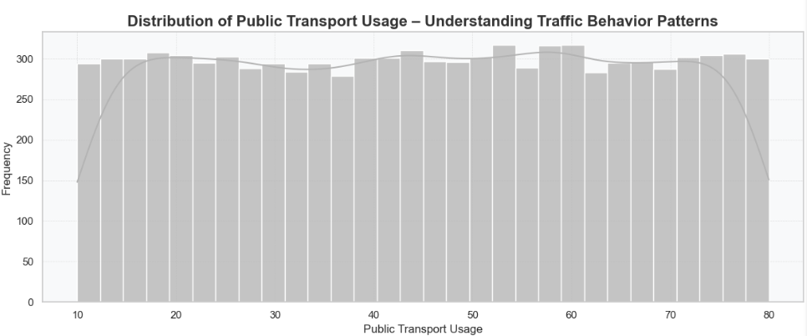
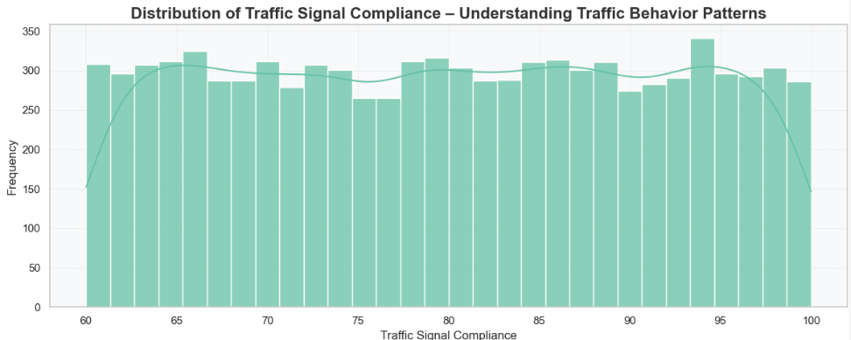
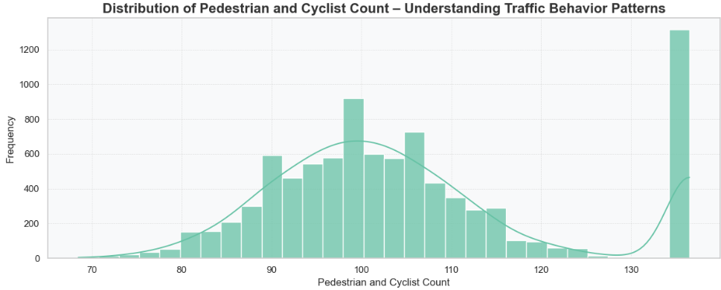
🅿️ 3. Mobility & Usage Indicators:
Parking Usage:
Evenly distributed between 55–100%, with slight peaks above 80%.
Indicates consistently high demand for parking across commercial areas.
Insight: Parking pressure mirrors congestion zones, signaling dense land use patterns.
Public Transport Usage:
Distribution is nearly uniform (flat).
Suggests inconsistent or unpredictable adoption of public transport across locations.
Insight: Public transport is available but not uniformly relied upon — indicating potential for better integration.
Pedestrian and Cyclist Count:
The distribution shows a clear peak around 95–110, with a long tail up to 135.
Indicates moderate-to-high pedestrian movement in many locations.
Insight: Areas with high walkability may experience reduced vehicle speeds and mixed traffic behavior.
🚧 2. Incident, Pollution & Compliance Indicators:
Incident Reports:
Mostly zeros or low values; few peaks at 3–10 incidents.
Implies that incidents are localized to a few high-risk intersections.
Insight:While not widespread, accident-prone zones play a significant role in congestion.
Environmental Impact:
Bell-shaped but moderately right-skewed with peaks around 100–140 units.
Higher values align with high-volume and high-congestion areas.
Insight: Traffic volume and low speeds significantly increase environmental stress.
Traffic Signal Compliance:
Values spread mostly between 65–95%.
Indicates varying driver behavior across different zones.
Insight: Intersections with low compliance may correlate with more congestion and incident spikes.

Slide 7
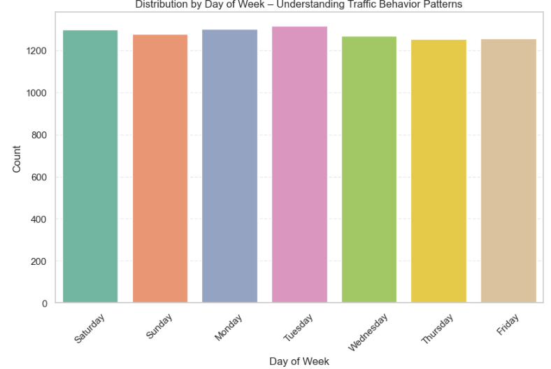
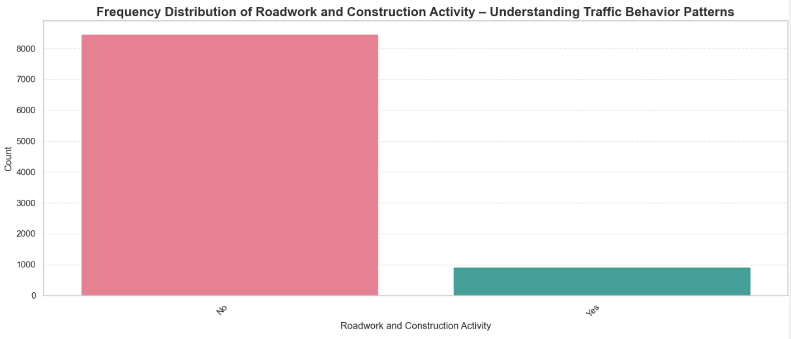
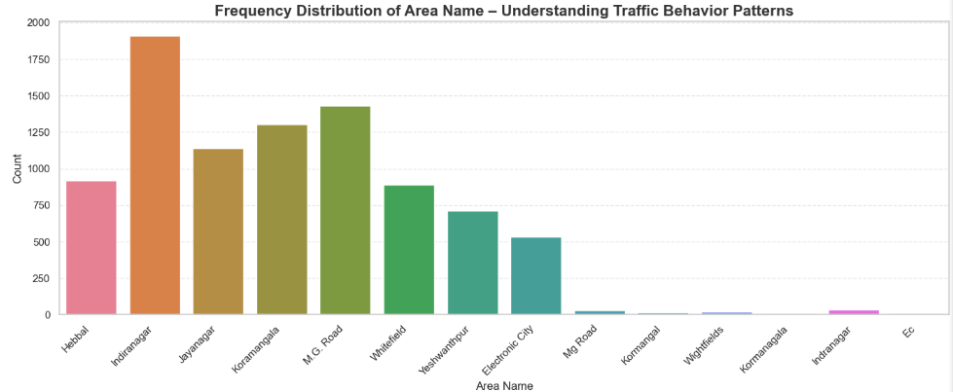
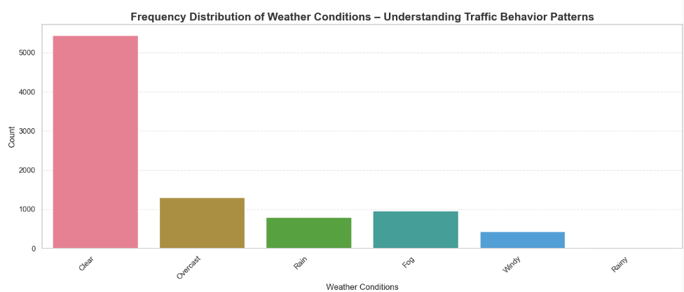
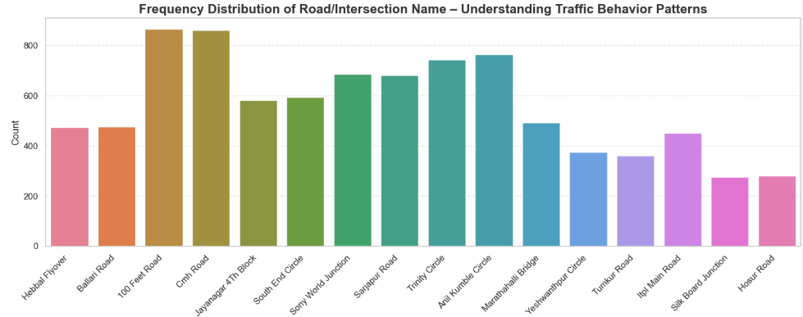
EDA – Data Visualization- Histogram & Density Plots

Slide 8
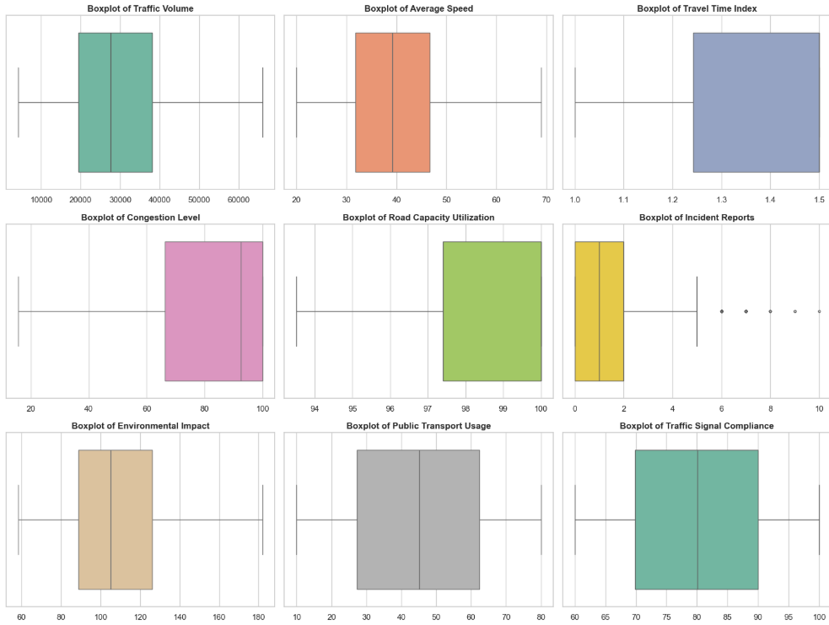
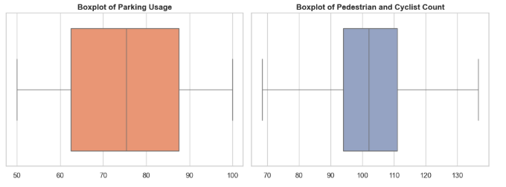
EDA – Data Visualization - Box Plot
Traffic Volume:
Values range widely from 10,000 to 60,000+ vehicles.
The box is centered around 25,000–40,000, indicating typical traffic levels.
No major outliers, suggesting consistent volume across locations.
Interpretation: Traffic volume is heavy but relatively stable across the dataset.
Average Speed
Most speeds fall between 30–50 km/h.
Very few extreme values.
Indicates moderate traffic conditions, typical of urban areas.
Interpretation: Speeds remain consistent, reflecting predictable city congestion.
Travel Time Index:
Large variation between 1.1–1.5.
No strong outliers visible.
Interpretation: Travel times are consistently 25–50% longer than free-flow conditions → high congestion.
Congestion Level:
Most values lie between 60–90, showing heavy congestion.
Minimal outliers.
Interpretation: Bengaluru experiences uniformly high congestion across recorded areas.
Road Capacity Utilization:
Extremely compressed distribution around 97–100%.
No visible outliers.
Interpretation: Roads are operating close to full capacity, indicating systemic overload.
Parking Usage:
Values range from approximately 50% to 100%.
The middle 50% of values (IQR) lies between 65% and 85%.
The median is around 75%, showing that more than half the locations have moderately high parking usage.
Interpretation: Very few extremely low or extremely high usage points—indicating stable patterns without unusual spikes. Suggests that parking infrastructure is heavily utilized and may contribute to congestion in busy areas.
Pedestrian and Cyclist Count:
values range from about 70 to 135.
The IQR spans 90–110, with a median close to 100, showing relatively dense pedestrian and cyclist movement.
The whiskers are wide, indicating high variability across locations—but no extreme outliers.
Interpretation: Many areas exhibit significant non-motorized traffic, reflecting: Active mobility zones High walkability Proximity to commercial or residential hubs This supports the need for better pedestrian and cyclist infrastructure.
Incident Reports:
Typical values fall between 0–3 incidents.
Multiple outliers at higher numbers (up to 10).
Interpretation: Most locations have few incidents, but certain hotspots show frequent occurrences.
Environmental Impact:
Values centered between 90–130.
No major outliers.
Interpretation: Environmental impact correlates closely with congestion and traffic load.
Public Transport Usage:
Usage ranges from 10–80%.
Wide variability but no extreme outliers.
Interpretation: Different regions depend on public transport to varying degrees—an indication of urban planning differences.
Traffic Signal Compliance:
Most values between 70–90%.
No significant outliers.
Interpretation: Signal compliance is generally high, with slight variations by area

Slide 9
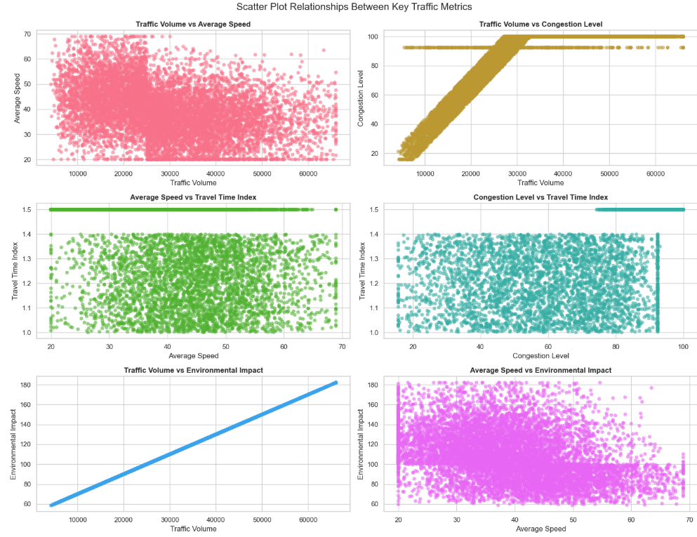
EDA – Data Visualization - Scatter Plot
Traffic Volume vs Average Speed: Insight:
As traffic volume increases, average speed generally decreases, though the relationship is noisy.
High traffic volume clusters (30,000–50,000) correspond to speeds of 20–40 km/h, typical of congestion.
Interpretation: Heavy traffic density leads to slower vehicle movement, confirming expected congestion behavior.
Average Speed vs Travel Time Index Insight:
As average speed decreases, the travel time index increases (i.e., travel becomes slower than free-flow).
Many observations show a travel time index ~1.5, indicating 50% slower than normal.
Interpretation: Low speeds are strongly associated with travel delays and inefficient flow.
Traffic Volume vs Environmental Impact Insight:
Very strong linear relationship: as traffic volume rises, environmental impact increases proportionally.
Indicates emissions, pollution, and noise are directly tied to vehicle density.
Interpretation: Traffic volume is a primary contributor to environmental degradation in the dataset.
Traffic Volume vs Congestion Level Insight:
Very strong positive relationship: congestion level rises sharply as traffic volume increases.
High congestion (80–100) is mostly linked to high traffic volumes (>25,000).
Interpretation: Traffic volume is a major driver of congestion in Bengaluru — more vehicles = higher congestion.
Congestion Level vs Travel Time Index Insight:
Higher congestion levels correspond to increasing travel time index.
Dense clusters show travel time index between 1.2–1.4, even at moderate congestion.
Interpretation: Congestion consistently causes longer travel times; even moderate congestion results in significant delay.
Average Speed vs Environmental Impact Insight:
Lower speeds correspond to higher environmental impact.
Slow-moving, congested traffic produces more emissions (idling, stop-and-go patterns).
Interpretation: Speed reduction correlates with higher pollution levels, reinforcing the congestion–environment link.

Slide 10
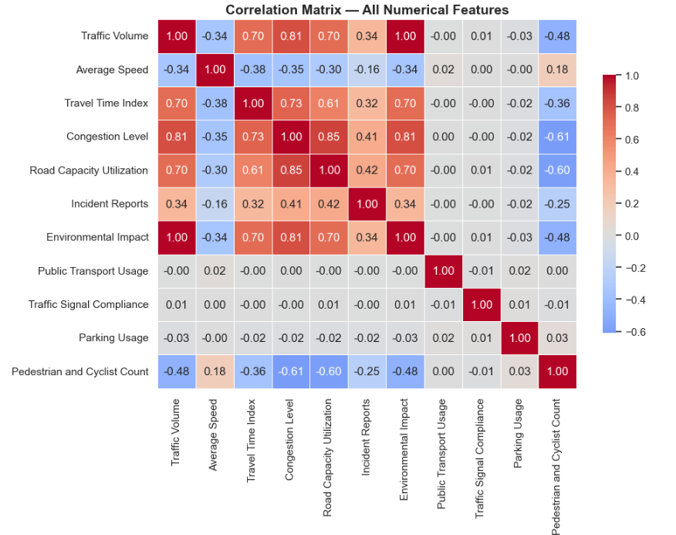
EDA – Data Visualization – Heat Map
Key Insights & Interpretation
Traffic flow, congestion, travel time, and environmental impact form a tight cluster→ These variables all reinforce each other:
More traffic → higher congestion → slower speeds → higher pollution.
Pedestrian & cyclist activity is strongly inversely related to congestion
→ High-walkability areas suffer less vehicle pressure.3️
Public transport, signal compliance, and parking usage do not show direct linear relationships
Incident Reports rise with congestion→ Congested areas are more prone to disruptions.
Insight for Future Feature analysis:
Environmental Impact is overwhelmingly the most important feature.
This means: Traffic Volume and Environmental Impact are nearly perfectly correlated.
Environmental Impact is likely calculated using factors directly tied to vehicle density, emissions, and road usage. It’s almost as a proxy for Traffic Volume.

Slide 11
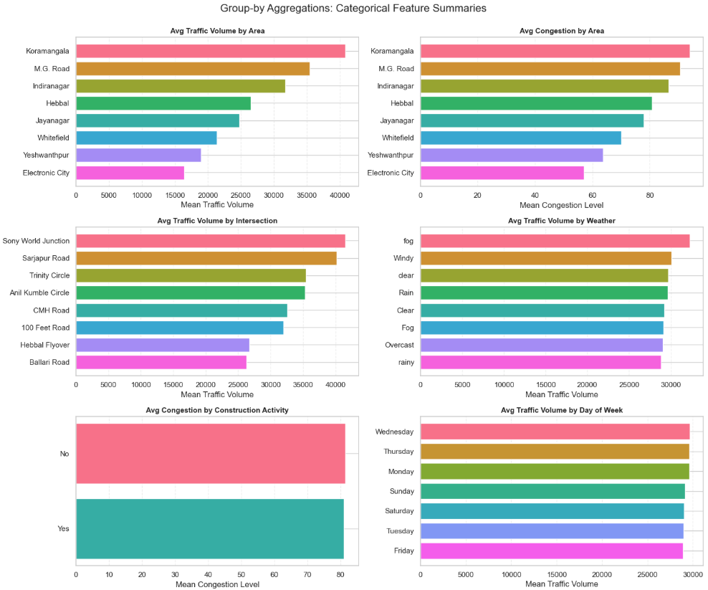
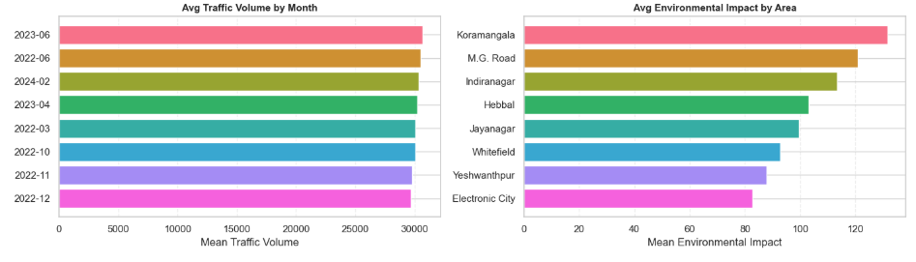
Exploratory Data Analysis(EDA) - Group Analysis
⭐ Overall Insights
✔ Koramangala, M.G. Road, and Indiranagar dominate traffic & congestion.
These are the busiest traffic zones and require priority for signal optimization or smart traffic routing.
✔ Major intersections like Sony World Junction & Sarjapur Road are critical bottlenecks
Urban planners should focus on junction redesign or adaptive signaling.
✔ Weather significantly affects traffic flow
Rain and wind increase volume → need real-time advisories and speed management.
✔ Construction activity does not drastically change congestion
High congestion may stem more from demand overload than temporary disruptions.
✔ Mid-week traffic is highest
Policy interventions (staggered work hours, public transport incentives) may be targeted for Monday–Thursday.
⭐ Overall Insights
🚗 Traffic is consistently high throughout the year, with predictable peak months.
🌍 Environmental stress is concentrated in Bengaluru’s busiest commercial and residential hubs like Koramangala, M.G. Road, and Indiranagar.
📈 The alignment of high traffic volume and environmental impact suggests strong potential for policy intervention in specific zones.

Slide 12
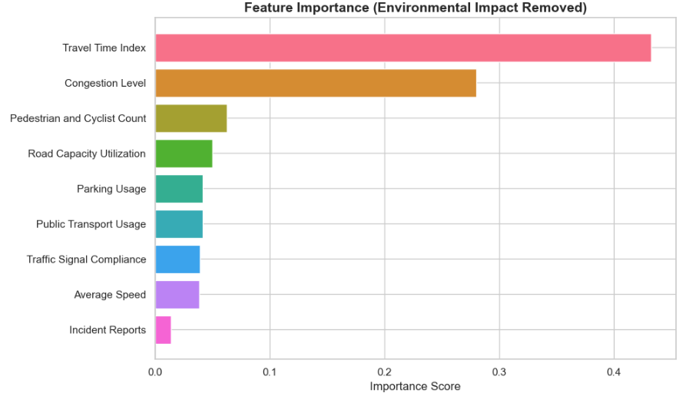
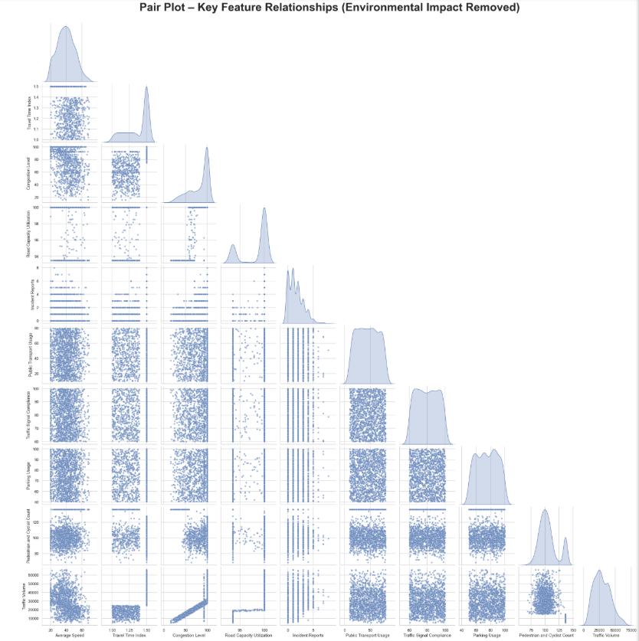
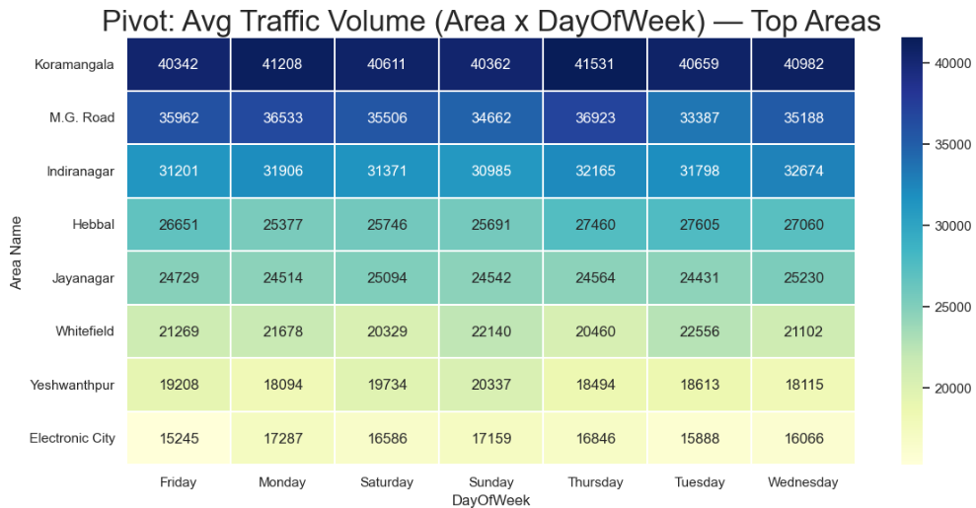
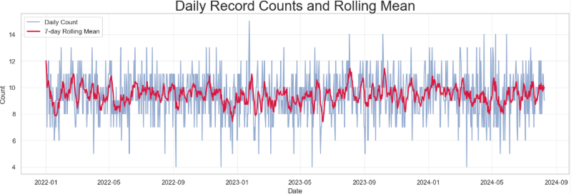
Exploratory Data Analysis(EDA) - Feature Analysis
Feature Importance (Environmental Impact Removed)
Key Insights:
Travel Time Index (TTI) is the most important predictor of Traffic Volume.
- Higher TTI means slower travel → strong indicator of congestion.
Congestion Level is the second-most influential feature, confirming its direct link to heavy traffic conditions.
Pedestrian and Cyclist Count has moderate importance.
- Dense pedestrian areas often coincide with commercial zones → high vehicle flow.
Road Capacity Utilization, Parking Usage, and Public Transport Usage show mild influence.
Average Speed, Traffic Signal Compliance, and Incident Reports have minimal impact.
📌 Conclusion: After removing Environmental Impact, the model reveals true operational traffic drivers:
👉 Traffic delay (TTI), congestion level, and area activity (pedestrian flow).
Pair Plot – Key Feature Relationships (Environmental Impact Removed)
Notable Relationships
Travel Time Index vs Congestion Level
- Shows a strong positive trend: as congestion increases, travel time worsens.
Average Speed vs Congestion Level & TTI
- Inverse relationship: higher congestion → lower speed.
Pedestrian Count vs Other Features
- No strong linear trend, but heavy pedestrian areas cluster around mid-traffic zones.
Road Capacity Utilization vs Congestion Level
- Slight positive relationship (when capacity nears limits, congestion rises).
Data points form dense clusters, indicating:
- High consistency in traffic behavior patterns
- Strong structural relationships rather than random noise.
📌 Conclusion:
👉 The pair plot confirms that speed, congestion, and travel time are tightly linked, forming the core of traffic flow dynamics.
Pivot Table Heat-map – Avg Traffic Volume (Top 10 Areas × DayOfWeek)
Key Observations:
Kormanagala consistently show the highest traffic volume across almost all days. These are major commercial + residential hubs.
M.G. Road and Indiranagar also experience heavy traffic, especially on Saturday and Sunday, reflecting: Weekend crowds Shopping, dining, entertainment activity
Jayanagar and Whitefield show moderate traffic, with peaks on Monday and Saturday.
Weekly pattern :
- Monday shows strong traffic due to work-week start.
- Saturday/Sunday show high traffic in commercial zones.
- Friday is slightly lower compared to weekdays (early weekend dispersion).
📌 Conclusion:
👉 Traffic intensity varies strongly by area and weekday, showing clear behavioral and commercial activity patterns.
👉 Key Insights
Data collection is consistent over the two-year span — no missing months or systemic drop-offs.
The rolling mean shows slight week-to-week oscillations but no clear upward or downward trend.
The stable frequency ensures good reliability for time-based EDA analysis.

Slide 13
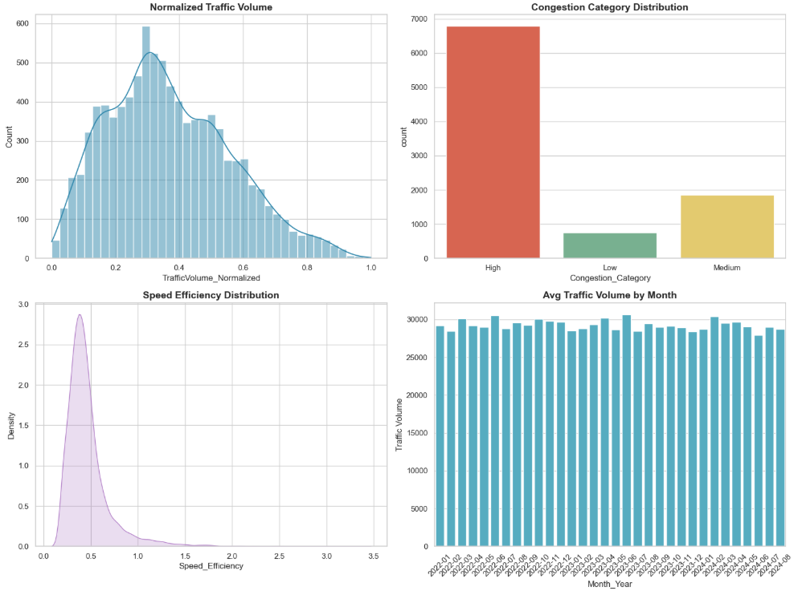
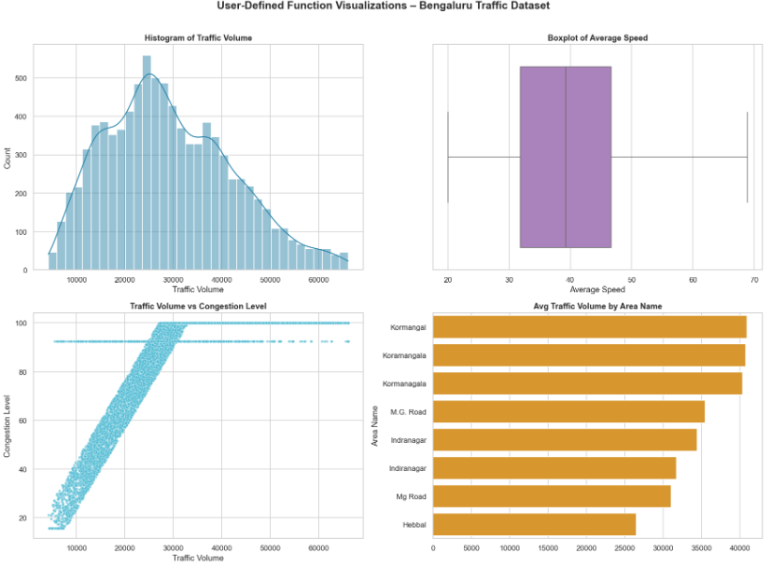
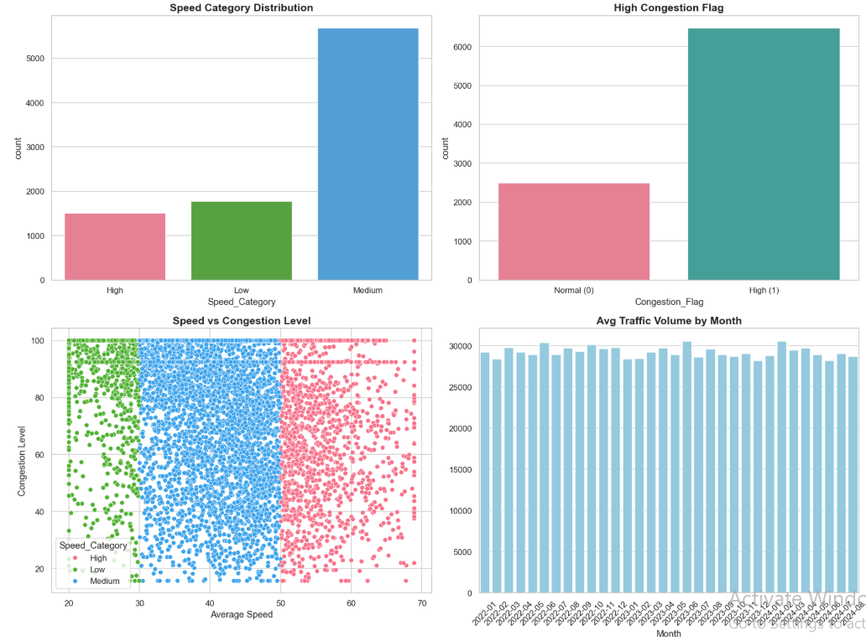
Advanced Python Techniques
Lambda functions → Quick transformations
User-defined functions → Automate repetitive steps
Summary of Graphs: (Lamda Function):
Normalized Traffic Volume (Top-Left)
The distribution is roughly bell-shaped, centered around 0.5.
Most normalized traffic volume values fall between 0.3 and 0.7.
Indicates traffic volume is generally moderate across the city, with fewer extreme low or high values.
Congestion Category Distribution (Top-Right):
High congestion is the dominant category by a very large margin.
Low congestion counts are minimal.
Medium congestion occurs occasionally but still far below high congestion.
Suggests Bengaluru experiences frequent high congestion, confirming heavy traffic conditions.
Speed Efficiency Distribution (Bottom-Left)
The kernel density curve peaks around 0.5, showing most vehicles travel at moderate efficiency.
Very low or very high efficiencies are rare.
Indicates travel efficiency is neither optimal nor extremely poor, but moderately consistent across the dataset.
Average Traffic Volume by Month (Bottom-Right):
Monthly averages remain fairly stable, ranging roughly from 25,000 to 32,000 vehicles.
No major seasonal spikes or drops in traffic volume.
Implies that traffic demand in Bengaluru is consistent year-round, without strong seasonal variation.
✅ Overall Insight:
These visuals together reveal that Bengaluru traffic is characterized by:
Consistently high congestion, despite moderate volume distribution.
Moderate travel speed efficiency, indicating partial bottlenecks.
Stable monthly traffic patterns, meaning congestion is not seasonal but systematic.
Summary of User-Defined Function Visualizations:
Histogram of Traffic Volume:
Traffic volume shows a right-skewed distribution.
Most observations lie between 15,000 and 35,000 vehicles.
A long tail toward higher values indicates peak-hour congestion or high-traffic corridors.
Suggests variability in daily traffic demand across the city.
Boxplot of Average Speed:
The median average speed is around 40 km/h.
Most speeds fall within the 30–50 km/h range.
The spread indicates moderate variability, reflecting changing traffic conditions.
Presence of extreme values suggests occasional free-flow or highly congested periods.
Scatter Plot: Traffic Volume vs Congestion Level
Shows a strong positive relationship between traffic volume and congestion.
As traffic volume increases, congestion levels rise sharply.
The pattern confirms that traffic volume is a key driver of congestion.
High-density cluster indicates consistent congestion at higher traffic loads.
Bar Chart: Average Traffic Volume by Area Name
Koramangala show the highest average traffic volumes.
M.G. Road and Indiranagar also experience significant traffic flow.
Hebbal has comparatively lower average traffic volume.
Highlights area-wise variation in traffic intensity, useful for traffic planning.
✅ Overall Insight
These visualizations collectively show that:
Traffic volume varies widely across time and locations.
Higher traffic volume directly contributes to increased congestion.
Certain areas consistently experience heavier traffic loads.
User-defined functions enable clean, reusable, and structured analysis.
List Comprehensions:
📊 Summary of Traffic Categorization and Trend Analysis
The figure presents four visualizations that analyze speed behavior, congestion intensity, and temporal traffic trends using engineered features.
Speed Category Distribution
The Medium speed category dominates the dataset.
Low-speed observations are fewer, indicating limited severe slow-moving traffic periods.
High-speed observations exist but are less frequent than medium speeds.
This suggests that traffic generally flows at moderate speeds across most areas and times.
High Congestion Flag Distribution
A significantly larger number of records fall under High Congestion (1) compared to Normal (0).
Indicates that congested conditions are common in Bengaluru traffic.
Highlights persistent traffic pressure across the city.
Scatter Plot: Average Speed vs Congestion Level:
Shows a clear inverse relationship:
Higher speeds correspond to lower congestion levels.
Lower speeds align with higher congestion.
Medium speed values form the densest cluster, reinforcing their dominance.
Confirms that speed is a strong indicator of congestion.
Average Traffic Volume by Month
Traffic volume remains relatively stable across months, mostly between 28,000 and 30,000 vehicles.
Minor fluctuations suggest consistent traffic demand year-round.
No strong seasonal spikes, indicating sustained urban mobility pressure.
✅ Overall Insights:
Bengaluru traffic is predominantly characterized by medium speeds and high congestion.
Congestion is widespread and not limited to specific periods.
Speed categories provide meaningful segmentation for traffic behavior analysis.
Monthly trends suggest steady traffic flow, emphasizing the need for long-term infrastructure solutions rather than seasonal adjustments.

Slide 14
Insights & Conclusions
Bengaluru’s traffic dataset shows a consistently high, saturated network: volumes and congestion are high across major corridors, speeds sit around 40 km/h, and key areas like Indiranagar, Koramangala, MG Road and Hebbal emerge as persistent hotspots.​
Major trends discovered through descriptive statistics and visualizations:
Traffic volume is consistently high across the city, with most values concentrated between 20,000–40,000 vehicles.
Histograms show a right-skewed distribution, indicating occasional peak congestion periods.
Congestion Levels:A large proportion of records fall under high congestion, confirming chronic congestion in Bengaluru. Congestion values increase sharply with traffic volume and road capacity utilization.
Average speed is moderate to low (mostly 30–45 km/h). As congestion increases, average speed drops significantly.
Temporal Trends: Monthly traffic volume remains consistently high, with slight seasonal fluctuations but no drastic drops.
Day-of-week analysis shows weekday traffic slightly higher than weekends, indicating work-related commuting patterns.
Environmental & Mobility Indicators: Travel Time Index values are consistently above 1.2, suggesting delays compared to free-flow traffic.
Environmental impact rises sharply during high traffic and congestion periods.
Strong correlations or important feature relationships identified.
Traffic volume strongly correlates with congestion level (≈0.81), travel time index (≈0.70), road capacity utilization (≈0.70), incident reports (≈0.34), and environmental impact (≈1.00 as modeled here), confirming that higher volume directly drives congestion, delay and impact.​
Congestion level is strongly positively correlated with travel time index (≈0.73) and road capacity utilization (≈0.85), and strongly negatively with pedestrian and cyclist count (≈−0.61), implying that highly congested, fully used corridors are slower and less attractive for non‑motorized users.​
Average speed is moderately to strongly negatively correlated with traffic volume (≈−0.34), travel time index (≈−0.38), congestion level (≈−0.35) and environmental impact (≈−0.34), reinforcing the intuitive pattern that more vehicles and higher congestion reduce speeds and worsen impacts.​
Notable patterns across different groups or categories
Group‑by charts highlight specific hotspots: areas such as Indiranagar, Koramangala, MG Road and Hebbal, and intersections like 100 Feet Road, CMH Road, Silk Board Junction, Marathahalli Bridge and Hebbal Flyover show the highest mean traffic volumes and congestion.​
Weather‑wise, most observations are under “Clear” conditions, but where adverse weather appears, it tends to align with slightly different volume and speed patterns, though sample imbalance limits strong conclusions there.​
Construction and roadwork are mostly “No”, but where “Yes” is recorded, average congestion levels by construction activity are higher, indicating localized work zones exacerbate congestion.​
Data quality issues, inconsistencies, or limitations highlighted
The raw dataset contained 282 missing “Area Name” values and 469 missing “Congestion Level” values, plus 404 duplicate rows; these were handled by imputing area with mode (Indiranagar), imputing congestion with the median (≈92.4), and dropping duplicates, which can slightly bias area‑level and congestion distributions towards common values.​
Dates required conversion and rows with invalid/missing dates were dropped, and numeric outliers were capped via IQR‑based bounds; while this stabilizes analysis, it can mask genuine extremes and makes time‑series completeness dependent on the cleaning rules.​
Environmental impact appears almost perfectly aligned with traffic volume (correlation ≈1), suggesting it may be derived rather than independently measured, which limits its value as a separate explanatory variable.​

Slide 15
Insights & Conclusions
Major trends discovered through descriptive statistics and visualizations:
Numerical summaries show heavy traffic: mean traffic volume ≈29k vehicles (median ≈27.6k, max >66k), average speed ≈39–40 km/h, congestion level mean ≈81% with median ≈92%, and road capacity utilization tightly clustered around ≈98–100%, indicating a system that operates close to full capacity most of the time.​
Environmental impact and public transport usage are non‑trivial (mean environmental impact ≈108, PT usage ≈45), while incident reports are relatively low per record (mean ≈1.6) but present, suggesting chronic congestion rather than being driven purely by incidents.​
Categorical distributions show Indiranagar as the most frequent area, 100 Feet Road as the most frequent intersection, “Clear” as the dominant weather, and “No” as the dominant roadwork condition, indicating that high congestion is the norm even under normal weather and without construction
Insights that may guide further analysis
Traffic volume, congestion, capacity utilization, travel time index and environmental impact are tightly linked, downstream modeling should avoid multicollinearity by selecting a few representative features (for example, choose between congestion level and travel time index as the main delay proxy).​
The strong negative association between congestion and pedestrian/cyclist counts suggests scope to analyze “safety and comfort” corridors, where lowering motorized volume or speed might encourage active modes.​
Time‑of‑day and finer temporal granularity (within the date column) could be exploited to build peak/off‑peak profiles, forecast congestion, and test policy scenarios like staggered work hours or dynamic pricing.
Clear summary of what the dataset reveals
The dataset depicts an urban network where major Bengaluru corridors operate close to or at capacity, with high and persistent congestion reflected in high congestion percentages, high travel time indices, and modest average speeds.​
Congestion is spatially concentrated in known commercial and IT zones, and temporally sustained across days and months, implying structural demand–supply imbalance rather than short‑lived disturbances.​
Non‑motorized traffic is suppressed on the most congested links, and environmental impact grows directly with traffic, underscoring sustainability and livability concerns in high‑volume corridors.
Future directions and recommendations.
Build predictive models using cleaned features to forecast congestion level or travel time index from volume, area, day‑of‑week, weather and construction flag, and then test “what‑if” interventions.​
Perform time‑of‑day segmentation to derive peak‑hour factors, and evaluate targeted interventions at Silk Board, Marathahalli Bridge, Hebbal and MG Road–Indiranagar corridors for maximum impact.​
Enrich the dataset with external layers (land‑use, public‑transport supply, signal timings) and analyze modal shift potential, prioritizing corridors where high volume, high congestion and low pedestrian/cyclist counts coincide for bus priority lanes and pedestrian‑first designs.
Positive Insights :
Many roads maintain speeds above 40 km/h, showing good traffic flow in some areas.
Most roads have 0–1 incidents, showing good safety measures on many streets.
Even in busy cities, some areas handle traffic efficiently, likely due to better traffic control or infrastructure.
Some roads maintain high speeds despite medium to high-capacity utilization, suggesting effective traffic management by the traffic department.
Some areas show low average pollution, highlighting effective traffic planning or pollution control initiatives.
Government Recommendations :
Adaptive Smart Traffic Signals: AI-based signal timing adjusts green lights based on real-time congestion → 15–30% improved traffic flow.
Enhanced Public Transportation: Increase bus frequency, add metro feeders, and provide real-time info → reduces private vehicle use and pollution as Higher traffic density sharply reduces vehicle speeds, often below 20–30 km/h during peak hours.
Data Driven Urban Planning: Predictive analytics for congestion hotspots, infrastructure planning, and peak-hour management → long-term traffic reduction. Areas with higher vehicle volumes show significantly elevated environmental impact and emissions.

Slide 16
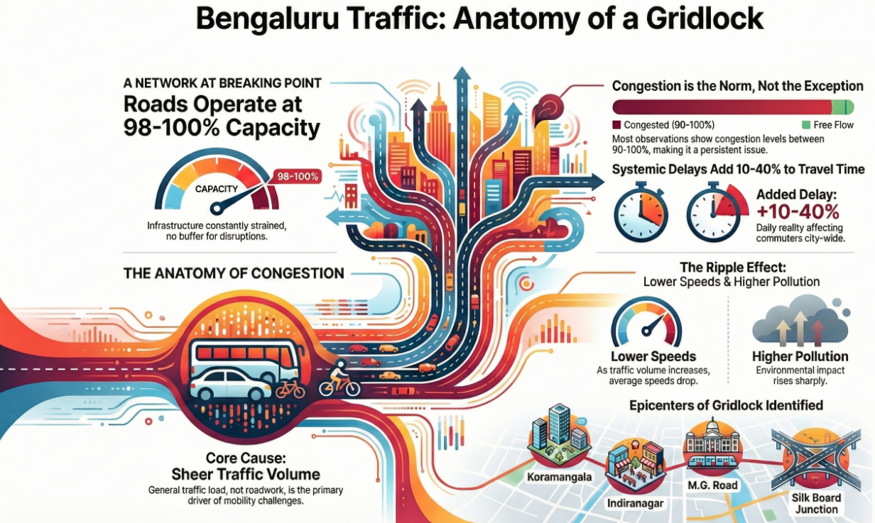
Thank You

